Slide 1
Tree

Slide 2
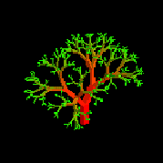
Nature View of a Tree
leaves
branches
root

Slide 3

Computer Scientist’s View
root
leaves
branches
nodes

Slide 4
Tree Data structure
A tree is a collection of nodes connected by directed (or undirected) edges(links).
A tree is a nonlinear data structure, compared to arrays, linked lists, stacks and queues which are linear data structures.
A tree can be empty with no nodes or consisting of one node called the root and zero or one or more subtrees (Recursive definition)
The root node splits the remaining nodes into subtrees/left sub tree/right sub tree

Slide 5
Tree
A tree has following general properties:
One node is distinguished as a root;
Every node (excluding root) is connected by a directed edge from exactly one other node called parent.
There is a ink from parent -> children

Slide 6
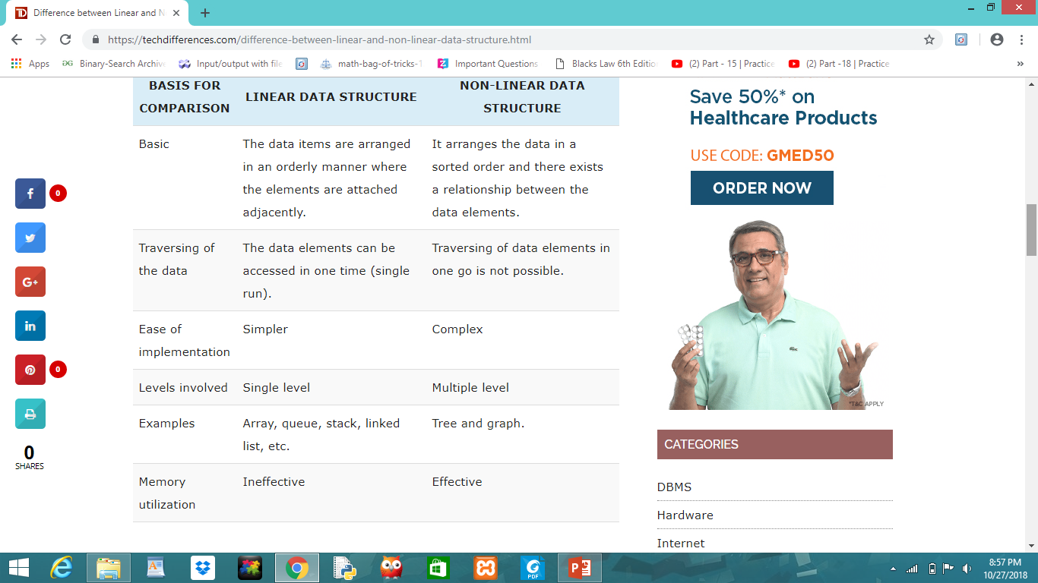

Slide 7
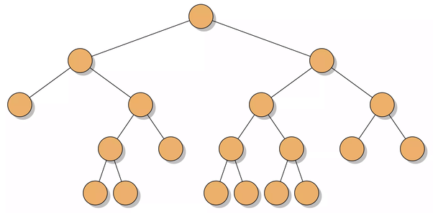
What is a Tree? Graphical representation of a Tree
A tree is a finite nonempty set of elements.
It is an abstract model of a hierarchical structure.
consists of nodes with a parent-child relation.
Applications:
Organization charts
File systems
Programming environments

Slide 8
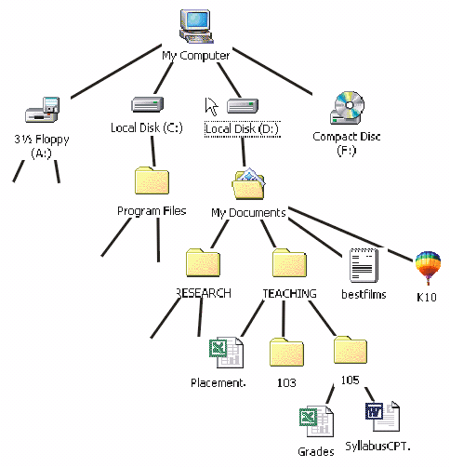

Slide 9
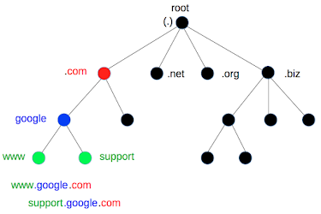
DNS Tree

Slide 10
Computers”R”Us
Sales
Manufacturing
R&D
US
International
Laptops
Desktops
Europe
Asia
Canada

Slide 11
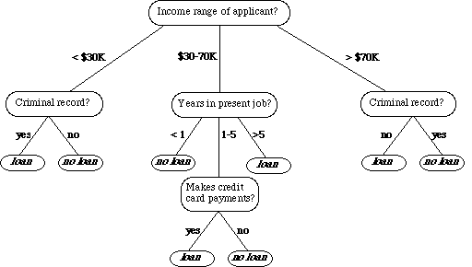
Process tree

Slide 12
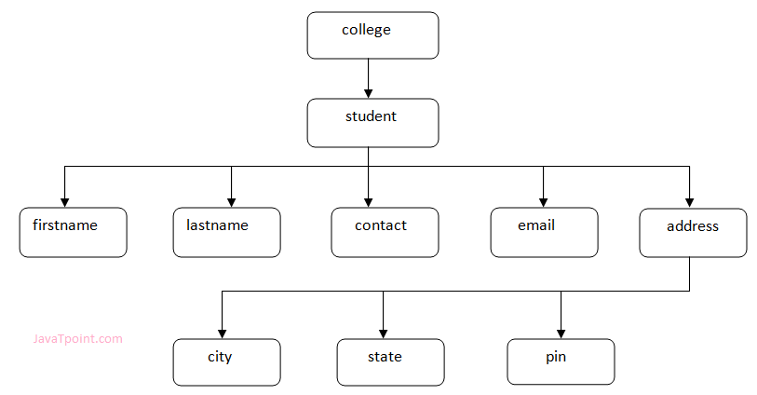
Information tree

Slide 13
Decision Tree
Binary tree associated with a decision process
internal nodes: questions with yes/no answer
external nodes: decisions
Example: dining decision
Want a fast meal?
Yes
No
How about coffee?
On expense account?
Yes
No
Yes
No
Starbucks
Spike’s
Al Forno
Café Paragon

Slide 14
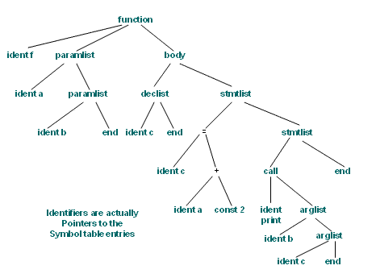
Syntax tree

Slide 15
Arithmetic Expression Tree
Binary tree associated with an arithmetic expression
internal nodes: operators
external nodes: operands
Example: arithmetic expression tree for the expression (2 × (a − 1) + (3 × b))
+
×
×
2
-
3
b
a
1

Slide 16
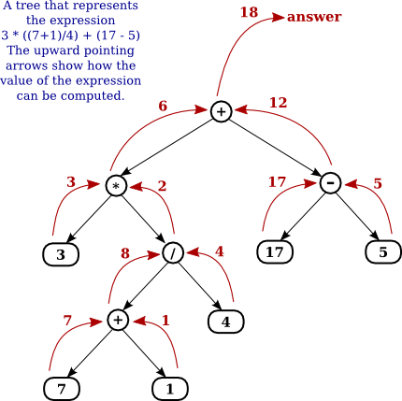

Slide 17
Tree Terminology

Slide 18
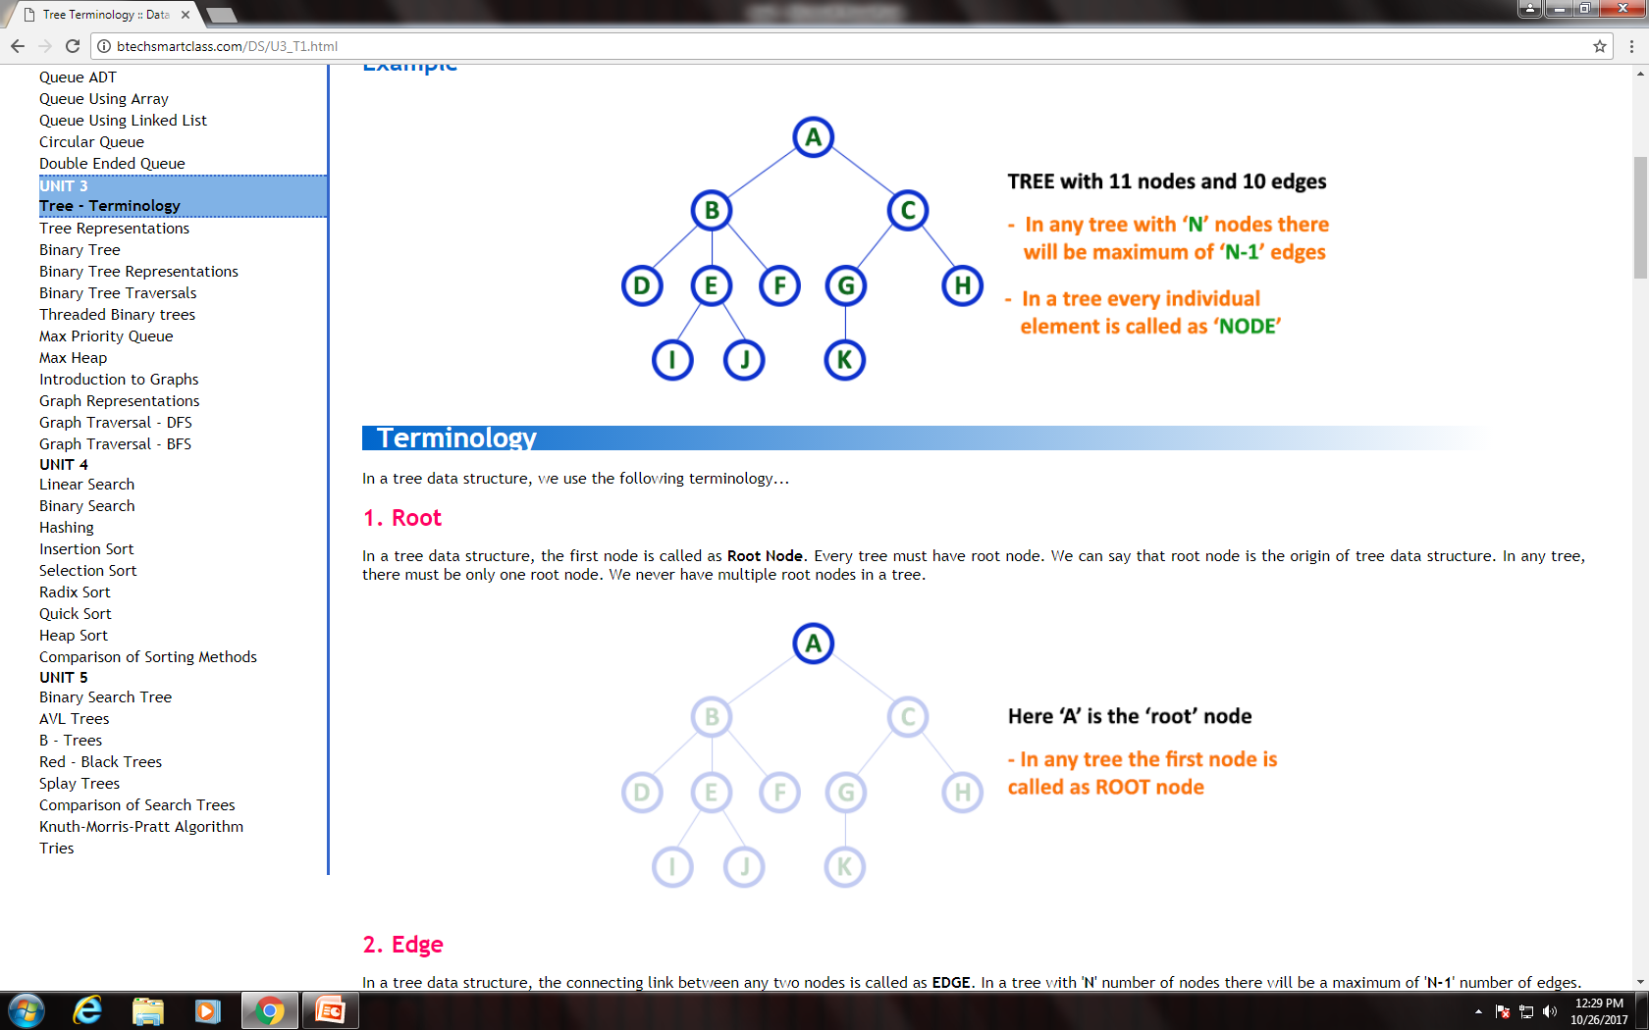

Slide 19
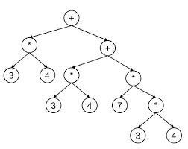
Tree with arrows (Not mandatory)

Slide 20
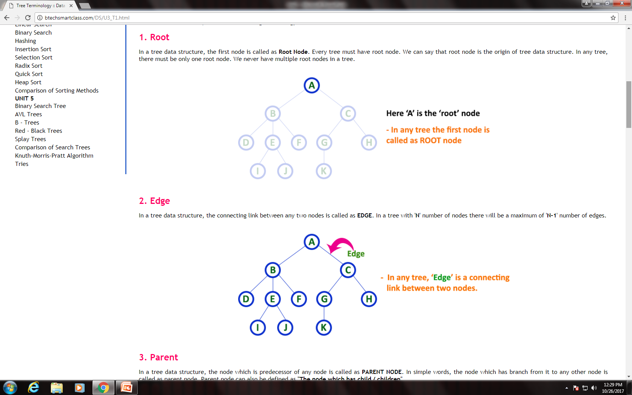
1. Root In a tree data structure, the first node is called as Root Node. Every tree must have root node. We can say that root node is the origin of tree data structure. In any tree, there must be only one root node. We never have multiple root nodes in a tree.

Slide 21
2. Edge In a tree data structure, the connecting link between any two nodes is called as EDGE. In a tree with 'N' number of nodes there will be a maximum of 'N-1' number of edges.

Slide 22
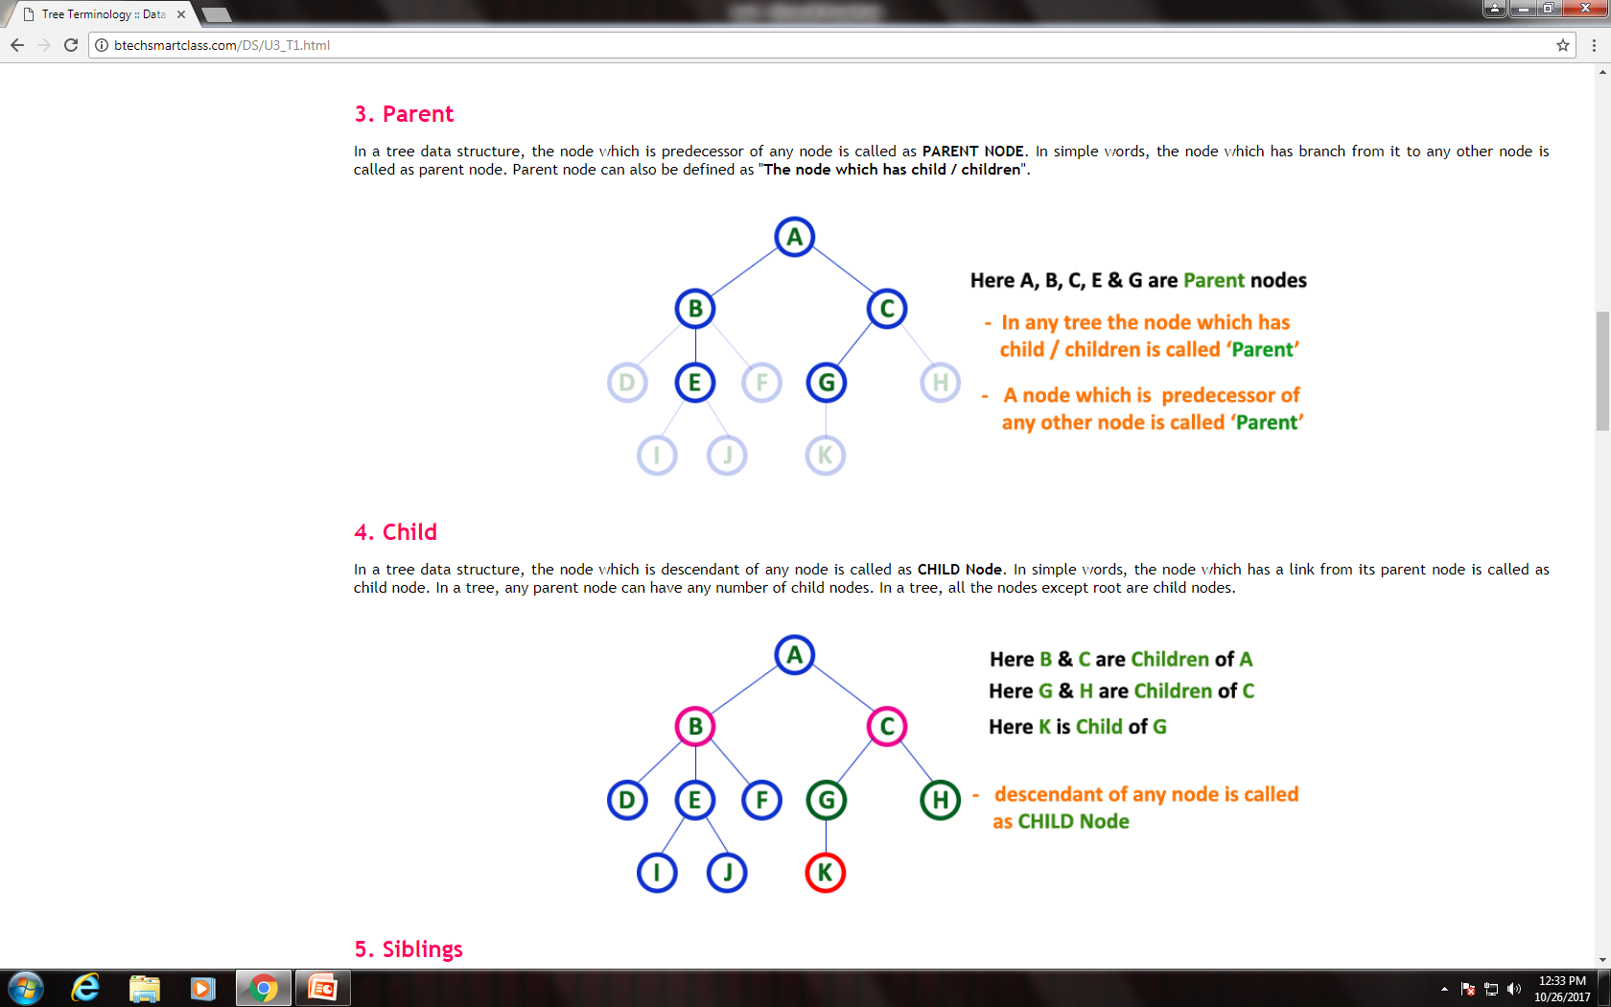
3. Parent In a tree data structure, the node which is predecessor of any node is called as PARENT NODE. In simple words, the node which has branch from it to any other node is called as parent node. Parent node can also be defined as "The node which has child / children".

Slide 23
4. Child In a tree data structure, the node which is descendant of any node is called as CHILD Node. In simple words, the node which has a link from its parent node is called as child node. In a tree, any parent node can have any number of child nodes. In a tree, all the nodes except root are child nodes.

Slide 24
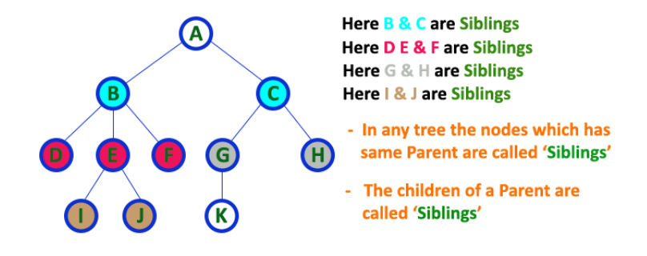
5. Siblings In a tree data structure, nodes which belong to same Parent are called as SIBLINGS. In simple words, the nodes with same parent are called as Sibling nodes.

Slide 25
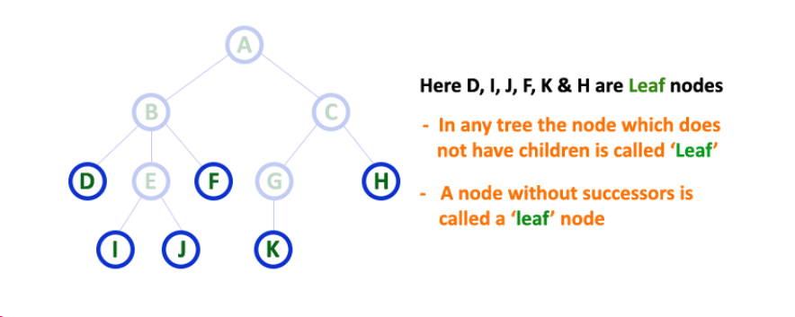
6. Leaf In a tree data structure, the node which does not have a child is called as LEAF Node. In simple words, a leaf is a node with no child. In a tree data structure, the leaf nodes are also called as External Nodes. External node is also a node with no child. In a tree, leaf node is also called as 'Terminal' node.

Slide 26
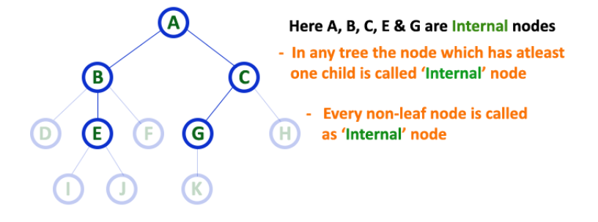
7. Internal Nodes In a tree data structure, the node which has atleast one child is called as INTERNAL Node. In simple words, an internal node is a node with atleast one child. In a tree data structure, nodes other than leaf nodes are called as Internal Nodes. The root node is also said to be Internal Node if the tree has more than one node. Internal nodes are also called as 'Non-Terminal' nodes.

Slide 27
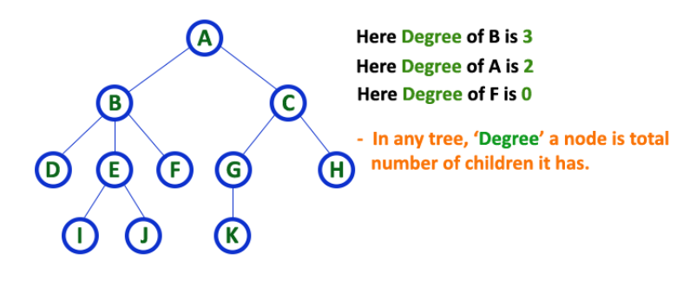
8. Degree In a tree data structure, the total number of children of a node is called as DEGREE of that Node. In simple words, the Degree of a node is total number of children it has. The highest degree of a node among all the nodes in a tree is called as 'Degree of Tree'

Slide 28
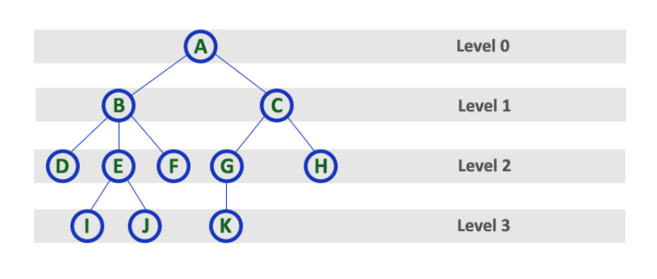
9. Level In a tree data structure, the root node is said to be at Level 0 and the children of root node are at Level 1 and the children of the nodes which are at Level 1 will be at Level 2 and so on... In simple words, in a tree each step from top to bottom is called as a Level and the Level count starts with '0' and incremented by one at each level (Step).

Slide 29
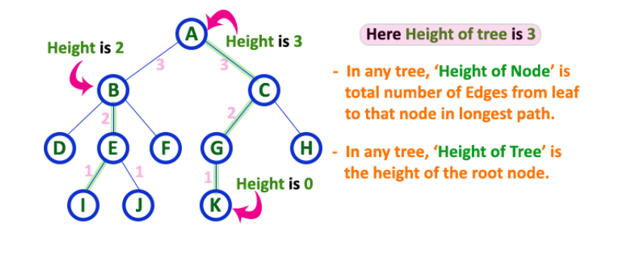
10. Height In a tree data structure, the total number of edges from leaf node to a particular node in the longest path is called as HEIGHT of that Node. In a tree, height of the root node is said to be height of the tree. In a tree, height of all leaf nodes is '0'.

Slide 30
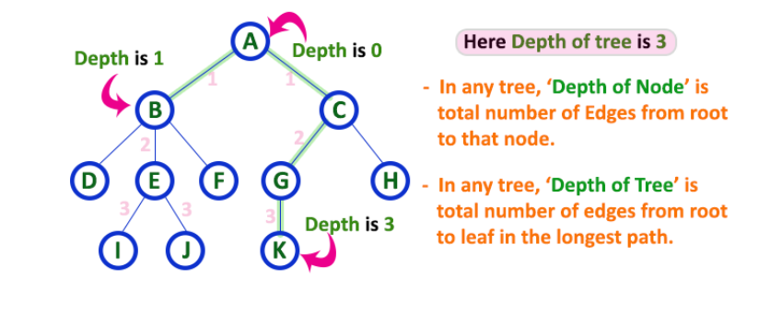
11. Depth In a tree data structure, the total number of egdes from root node to a particular node is called as DEPTH of that Node. In a tree, the total number of edges from root node to a leaf node in the longest path is said to be Depth of the tree. In simple words, the highest depth of any leaf node in a tree is said to be depth of that tree. In a tree, depth of the root node is '0'.

Slide 31
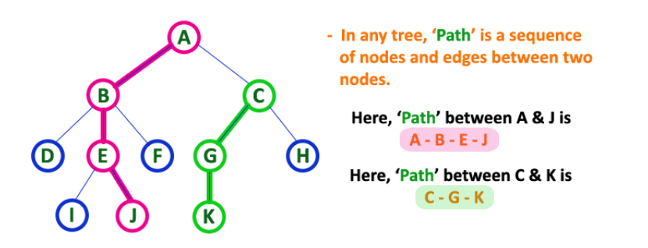
12. Path In a tree data structure, the sequence of Nodes and Edges from one node to another node is called as PATH between that two Nodes. Length of a Path is total number of nodes in that path. In below example the path A - B - E - J has length 4.

Slide 32
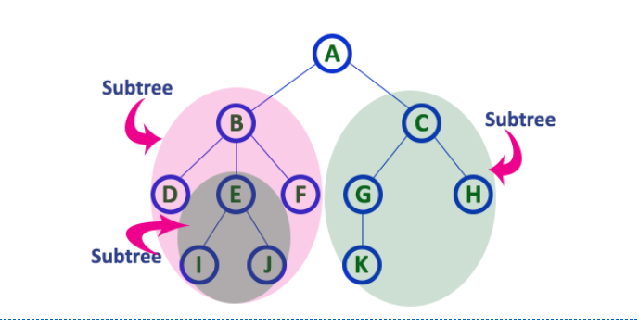
13. Sub Tree In a tree data structure, each child from a node forms a subtree recursively. Every child node will form a subtree on its parent node.

Slide 33
Ancestors of a node: parent, grandparent, grand-grandparent, etc.
Descendant of a node: child, grandchild, grand-grandchild, etc.
A
subtree
B
C
D
E
F
G
H
I
J
K

Slide 34
Types of Trees
General Tree
If no constraint is placed on the hierarchy of the tree, a tree is called a general tree. Every node may have infinite numbers of children in General Tree. The tree is the super-set of all other trees.

Slide 35
Types of Trees
Binary Tree
The binary tree is the kind of tree in which at most two children can be found for each parent known as left child and right child forming left and right sub-trees
3-ary tree / n-ary tree have at most 3/n children.

Slide 36
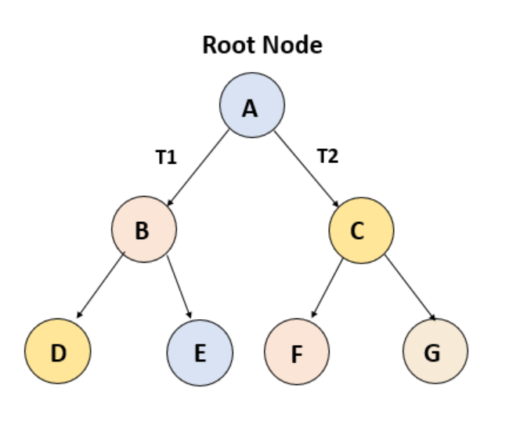

Slide 37
Types of Trees
3. Binary Search Tree
Binary Search Tree (BST) is a binary tree extension with several optional restrictions. The left child value of a node should in BST be less than or equal to the parent value and the right child value should always be greater than or equal to the parent’s value. This Binary Search Tree property makes it ideal for search operations since we can accurately determine at each node whether the value is in the left or right sub-tree. This is why the Search Tree is named.

Slide 38


Slide 39
Types of Trees
AVL Tree
AVL tree is a self-balancing binary search or balanced binary search tree.
On behalf of the inventors Adelson-Velshi and Landis, the name AVL is given.
This was the first tree that balanced dynamically.
A balancing factor is allocated for each node in the AVL tree, based on whether the tree is balanced or not.
The height of the node kids is at most 1.
In the AVL tree, the correct balance factor is 1, 0 and -1. If the tree has a new node, then it will be rotated to ensure that the tree is balanced. It will then be rotated. Common operations such as viewing, insertion, and removal take O(log n) time in the AVL tree. It is mostly applied when working with Lookups operations.

Slide 40


Slide 41
Types of Trees
5. Red-Black Tree
Another kind of auto-balancing tree is red-black. The red-black name is given because the Red-black tree has either red or Black painted on each node according to the red-black tree’s properties.
It maintains the balance of the forest. Even though this tree is not a fully balanced tree, the searching operation only takes O (log n) time. When the new nodes are added in Red-Black Tree then nodes will be rotated again to maintain the Red-Black Tree’s properties.

Slide 42
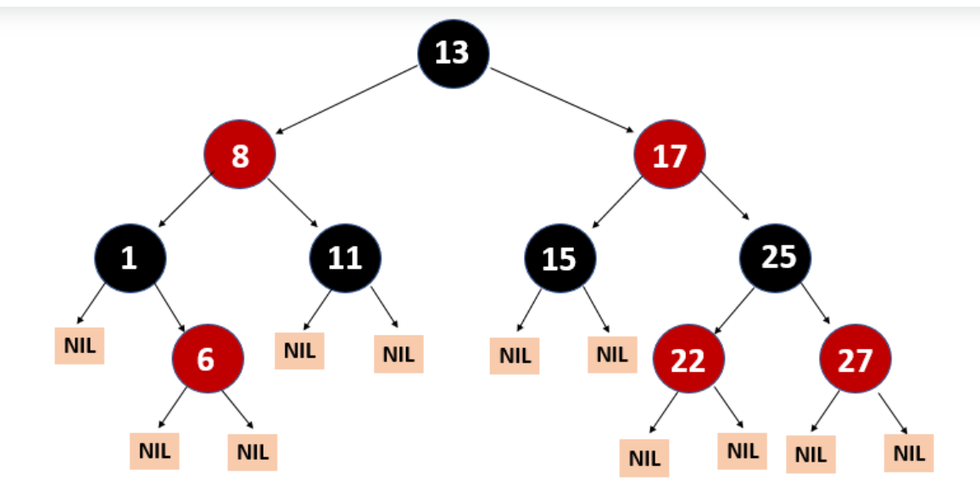

Slide 43
Some more types of trees:
B- Trees
B+ Trees
Min and Max Heaps
Splay Trees
2-3 Trees

Slide 44
Binary Tree

Slide 45
Binary Tree
A binary tree is a tree with the following properties:
Each internal node has at most two children (degree of two)
The children of a node are an ordered pair
We call the children of an internal node left child and right child
Alternative recursive definition: a binary tree is either
a tree consisting of a single node, OR
a tree whose root has an ordered pair of children, each of which is a binary tree
A
B
C
D
E
F
G
H
I

Slide 46
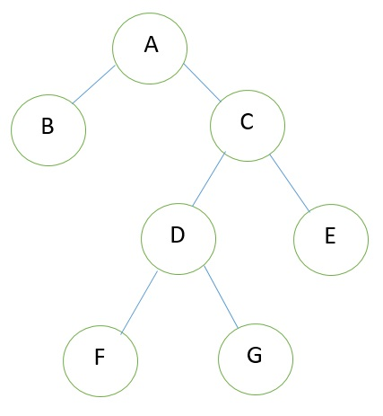
Strictly/Full Binary tree
Every non leaf node/internal node
has exactly 2 children

Slide 47
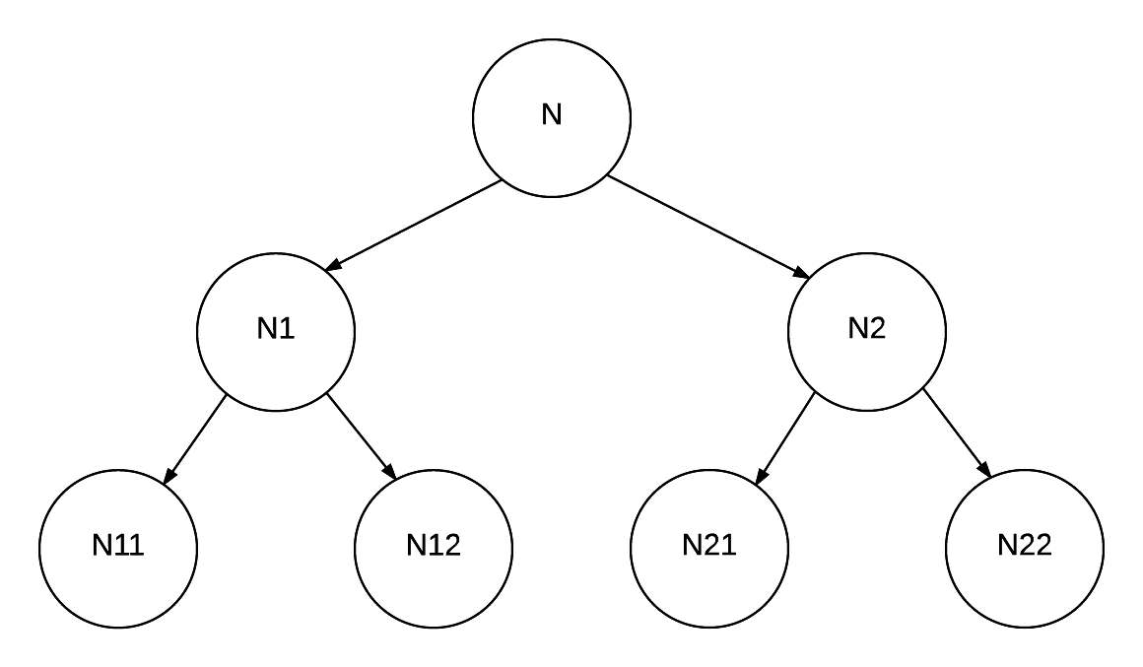
perfect binary tree
A binary tree with all leaf nodes at the same depth. All internal nodes have degree 2.

Slide 48
Is this a tree?
A
B
C
D
E

Slide 49
Examples of the Binary Tree
Skewed Binary Tree
Complete Binary Tree
A
A
A
B
B
B
C
C
D
E
F
G
D
H
I
E

Slide 50
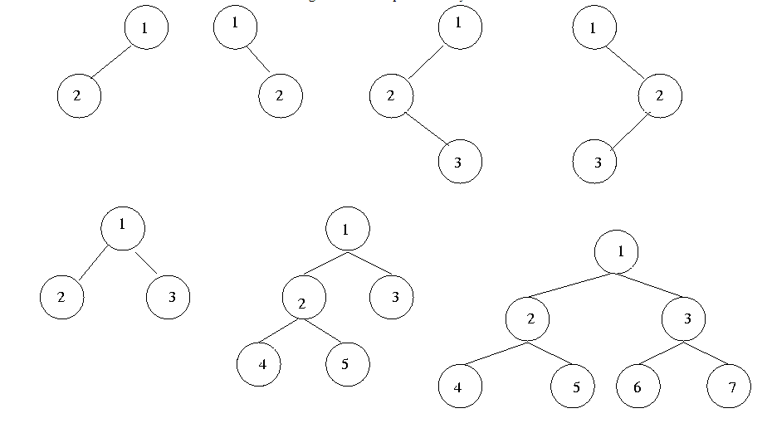
Examples of a binary tree

Slide 51
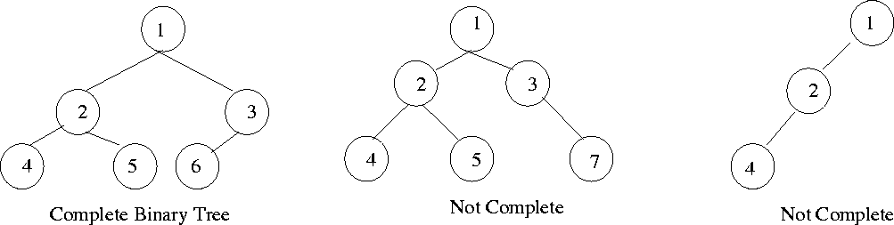
Complete Binary Tree
A complete binary tree is a binary tree in which every level, except possibly the last, is completely filled, and all nodes are as far left as possible.

Slide 52
Differences Between A Tree and A Binary Tree
The subtrees of a binary tree are ordered; those of a tree are not ordered.
A
A
B
B
Are different when viewed as binary trees.
Are the same when viewed as trees.

Slide 53
Binary Tree representation
Representation means?

Slide 54
Representation 1: Linked representation (data, parent, left subtree, right subtree)
A node is represented by an object storing
Element
Parent node address
Left child node address
Right child node address
∅
B
∅
∅
B
A
D
A
D
∅
∅
∅
∅
C
E
C
E

Slide 55
Representation 2 : data, left subtree, right subtree
We use double linked list to represent a binary tree. In a double linked list, every node consists of three fields. First field for storing left child address, second for storing actual data and third for storing right child address. In this linked list representation, a node has the following structure...

Slide 56
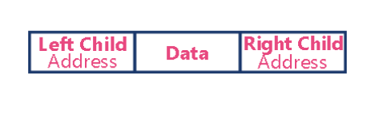

Slide 57
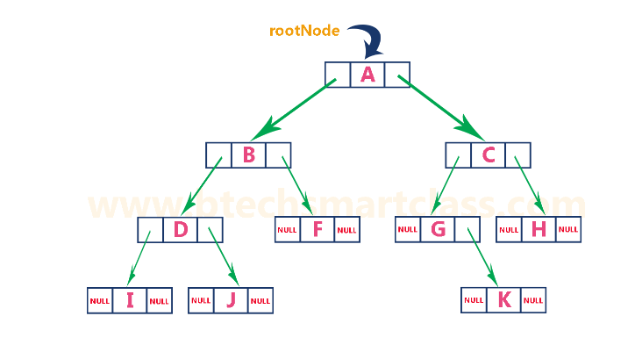

Slide 58
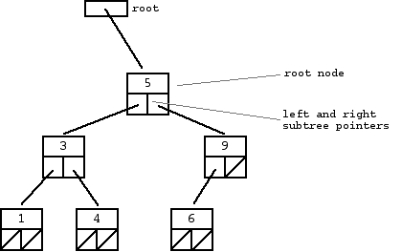

Slide 59
Representation 3: Explicit array representation

Slide 61
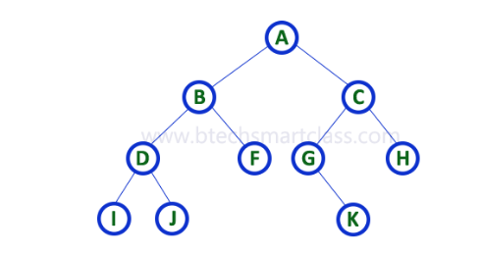

Representation 4: Implicit array representation.
Root is stored at index 0
Left child of node at index i is at index 2i +1
Right child of node at index i is at index 2i+2
0 | 1 | 2 | 3 | 4 | 5 | 6 | 7 | 8 | 9 | 10 | 11 | 12 | 13 | 14 | 15 | 16 | 17 | 18 | 19 | 20

Slide 62
Representation 5 :Left Child, Right Sibling Representation
Data
Left Child
Right Sibling
A
B
C
D
E
F
G
H
I
J
K
L

Slide 63
Answer the following:
How many maximum nodes can each level ‘i’ of a BT have?
If there are n nodes in a tree what is the maximum and minimum possible height/depth of tree?
If the height of a tree is ‘h’, then how many maximum/minimum nodes can it have

Slide 64
Answer the following:
How many maximum nodes can each level of a BT have?
2^{i}
If there are n nodes in a tree what is the maximum and minimum possible height/depth of tree?
max height = n-1
min height = (int) log₂ n
If the height of a tree is ‘h’, then how many maximum/minimum nodes can it have
2⁰ + 2¹ + 2² + 2² + … 2^{h} = 2^{h+1} – 1 (maximum)
Minimum = h+1

Slide 65
Binary Search Tree
Binary Search Tree is a node-based binary tree data structure which has the following properties:
The left subtree of a node contains only nodes with keys lesser than the node’s key.
The right subtree of a node contains only nodes with keys greater than the node’s key.
The left and right subtree each must also be a binary search tree.

Slide 66
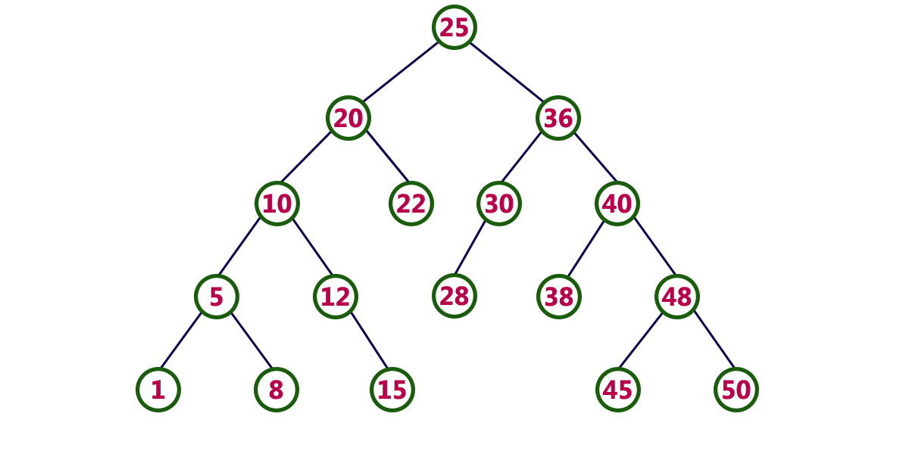
Binary Search Tree

Slide 67
Operations on a Binary Tree/ Binary Search Tree
Create Tree
Insert node in a tree
Traverse tree to display contents of all nodes
Search for key
Remove a node
Find height/ depthremove()
Count number of nodes in a tree
Count number of leaf nodes in a tree
Create a copy of tree/subtree
and many more depending on application

